Slide 1



AI-Driven Loan Default Prediction Using Banking Analytics
An explainable machine-learning framework across three public credit datasets
S. Tejasree, B. Sruthi, B. Bhavya Sai Sree
Department of Computer Science and Engineering, KLH University, Hyderabad
Data Analytics & Visualisation – 1 (24DSB3101) | Guide: Dr.K. Swapnika
Notes:
Introduce the project: an explainable ML framework for loan default prediction using three public credit datasets. Project report for Data Analytics & Visualisation - 1, guided by K. Swapnika.

Slide 2



Background & Problem Statement
Defaults hurt banks
Rising defaults and NPAs reduce profitability, liquidity and financial stability.
Core research problem
Develop an explainable machine-learning framework that predicts loan defaults across multiple credit datasets, with transparent model comparisons and understandable credit-risk insights.
Traditional scoring struggles
Large, complex, imbalanced and fragmented data are hard to handle with scores and manual rules.
Accuracy is not enough
Credit decisions must be transparent, so explainable AI (SHAP, LIME) is needed.
Notes:
Defaults and NPAs threaten bank stability. Existing work focuses on accuracy, but banks need transparent decisions.

Slide 3
Research Gap
Limited multi-dataset validation
Most studies use one or two datasets, which limits generalizability.
Explainability comes late
SHAP or LIME is often applied only after the final model is chosen.
1
2
Performance vs interpretability
Stronger models tend to be harder to explain.
Little decision support
Dashboards and visual credit-risk insights are rarely provided.
3
4
Our answer: 3 datasets + 5 models + SHAP & LIME + visualization dashboard
Notes:
Four gaps from the literature: limited datasets, late explainability, performance-interpretability trade-off, and missing decision-support layers.

Slide 4
Objectives & Research Questions
Objectives
Research questions
1
Design a default-prediction framework with preprocessing, EDA and risk-aware features
RQ1
How do the five models compare across datasets?
2
Compare five ML models
RQ2
Which model best balances performance and interpretability?
3
Validate on three public credit datasets
RQ3
How consistent are results and key features across datasets?
4
Measure with Accuracy, Precision, Recall, F1, ROC-AUC, plus SHAP and LIME
Build a dashboard for risk insights
RQ4
How can explanations and visuals support credit-risk decisions?
5
Notes:
Five objectives and four research questions guide the study.

Slide 5
Methodology
Six steps, applied identically to each dataset
1
Data collection
2
Preprocessing
3
Exploratory analysis
Lending Club, Statlog German Credit and Home Credit, each processed separately.
Missing values, duplicates, encoding, outliers, class imbalance (SMOTE or weights), scaling.
12+ analytical techniques to understand distributions and default patterns.
4
Feature engineering
5
Model training
6
Evaluation & explanation
Risk-aware features: debt-to-income ratio, credit utilization, repayment consistency.
Logistic Regression, Decision Tree, Random Forest, XGBoost, CatBoost with stratified split; tuning on training data only.
Accuracy, Precision, Recall, F1, ROC-AUC; SHAP and LIME; results shown in a dashboard.
Notes:
Methodology summary: six steps from data collection to evaluation and explanation, applied to all three datasets.

Slide 6
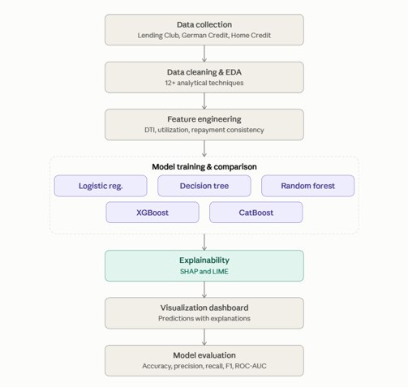
SYSTEM WORK FLOW

Slide 7






Proposed Framework
Datasets
Preprocessing & EDA
Feature engineering
Model training
Explainability
Dashboard
Lending Club, German Credit, Home Credit
Cleaning plus 12+ analytical techniques
DTI, credit utilization, repayment consistency
Five models compared
SHAP (global) and LIME (local)
Results and risk insights
One common pipeline for every dataset
Evaluated with Accuracy, Precision, Recall, F1-score and ROC-AUC.
Notes:
End-to-end pipeline: data, cleaning and EDA, feature engineering, five models, SHAP and LIME, then a dashboard.

Slide 8



Datasets
Lending Club
Statlog German Credit
Home Credit
Source: Public loan data
Source: UCI ML Repository
Source: Public dataset
Borrower and loan information for consumer loan repayment and default risk.
Borrower financial and credit attributes with a credit-risk label.
Consumer-finance data for predicting repayment difficulties.
Why: Large-scale consumer lending
Why: Classical benchmark
Why: Different risk setting; compares with prior work
All three go through the same preprocessing, modelling, evaluation and explainability pipeline, which addresses the single-dataset limitation.
Notes:
Datasets are processed separately because attributes, formats and targets differ.

Slide 9






Preprocessing & Feature Engineering
Risk-aware features
Missing values
Imputation or removal per variable
Data quality
Duplicates and inconsistent entries
Encoding
Categories to numeric form
Debt-to-income ratio
Credit utilization
Repayment consistency
12+ EDA techniques guide encoding and imbalance decisions before modelling.
Outliers
Check extreme values
Class imbalance
SMOTE or class weights
Scaling
For magnitude-sensitive models
Notes:
Each dataset is preprocessed separately. Engineered features capture borrower risk.

Slide 10
Models: Simple to Complex
1
Logistic Regression
Interpretable baseline for binary default
Baseline formulation
2
Decision Tree
Simple rule-based benchmark
P(Y=1 | X) = 1 / (1 + e^(−z))
z = β0 + β1X1 + … + βnXn
3
Random Forest
Tree ensemble for complex relationships
XGBoost
Gradient boosting for non-linear patterns
Y: default outcome. X1…Xn: input features. β: model parameters.
4
5
CatBoost
Boosting with strong categorical handling
Notes:
Simple-to-complex benchmarking: logistic regression gives an interpretable reference; boosting models are expected to capture non-linear patterns.

Slide 11
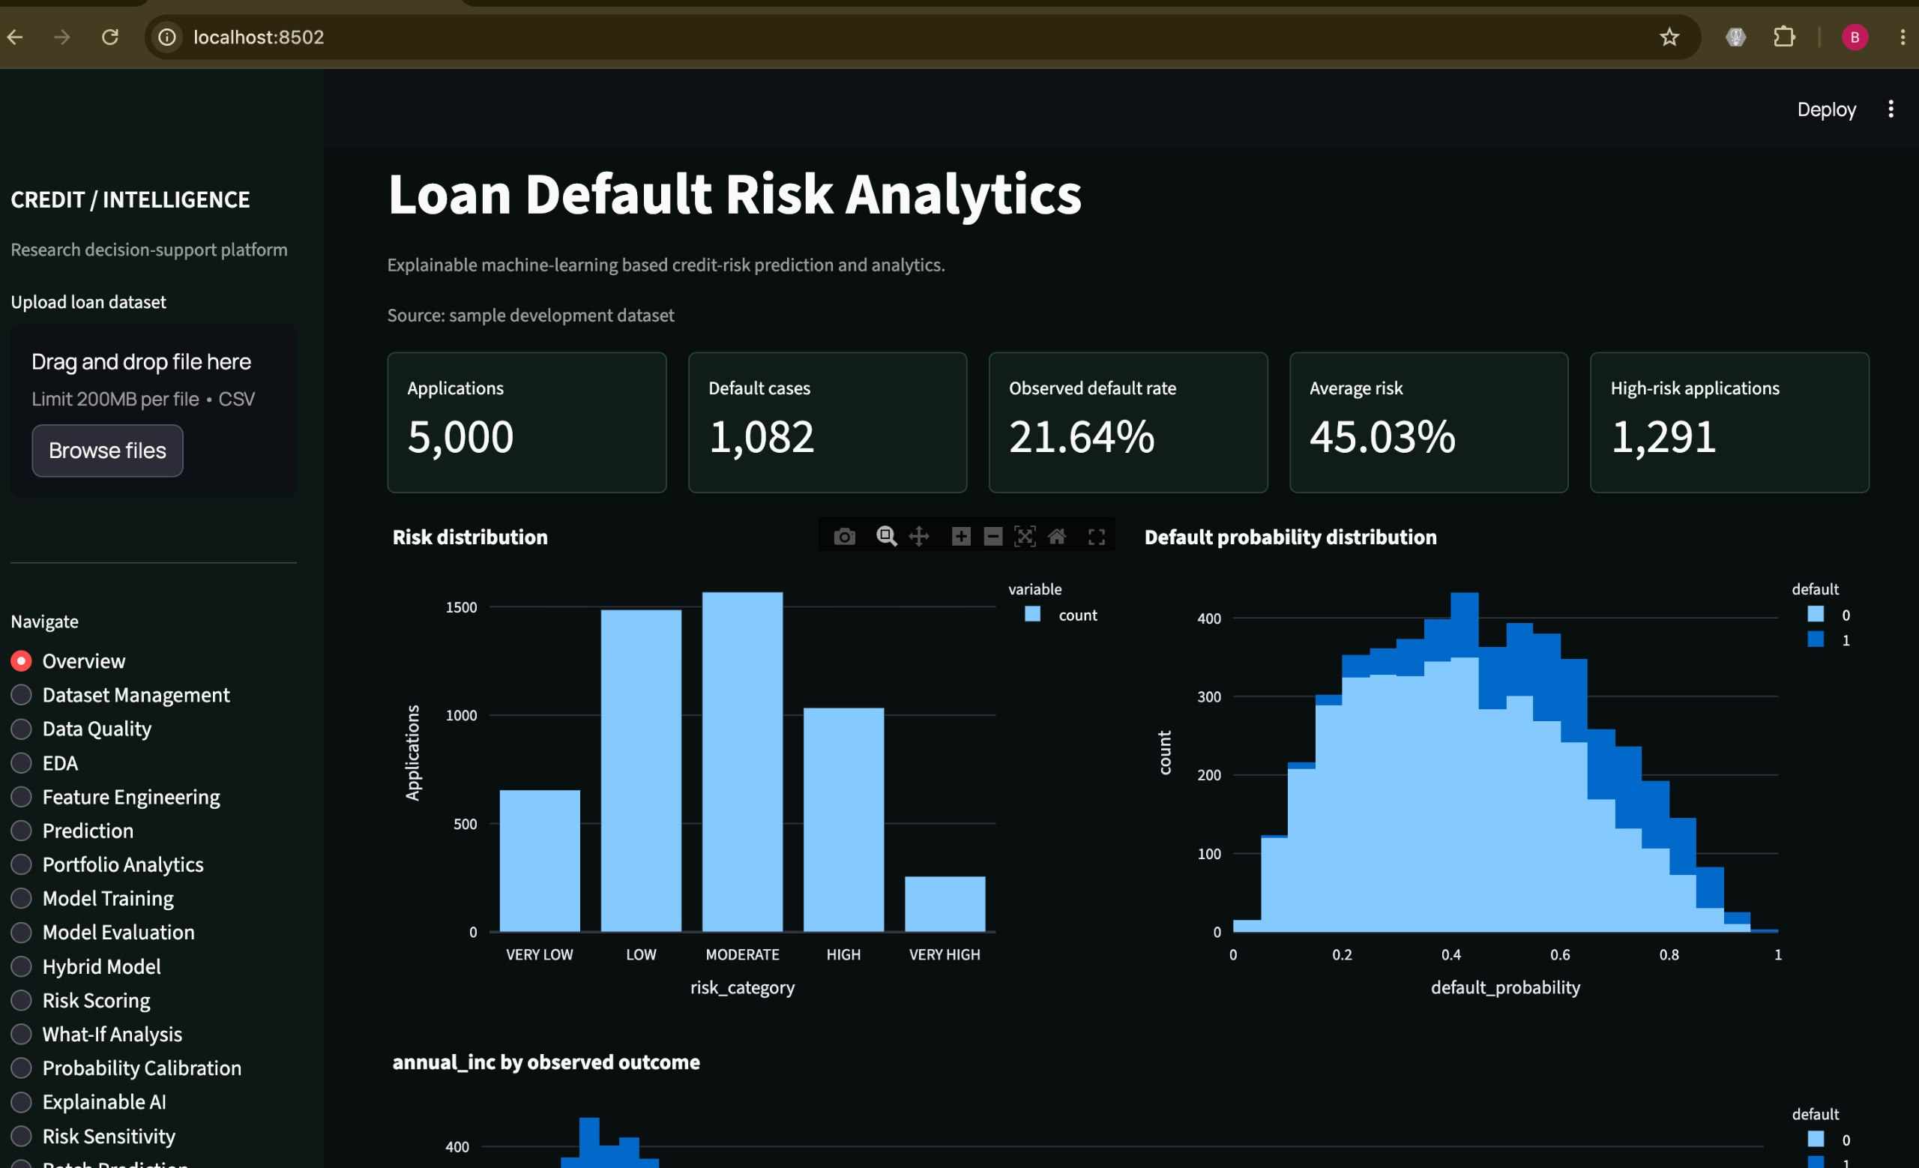

Slide 12


Explainability & Results Plan
Status: methodology and evaluation stage. Confirmed results will follow implementation and testing.
Model | Accuracy | Precision | Recall | F1 | ROC-AUC
Logistic Regression | – | – | – | – | –
Decision Tree | – | – | – | – | –
Random Forest | – | – | – | – | –
XGBoost | – | – | – | – | –
CatBoost | – | – | – | – | –
SHAP
Global feature importance
LIME
Explains individual predictions
Confusion matrix
Focus on missed defaults (false negatives)
Dashboard
Performance, features, risk insights
Planned comparison, repeated for each of the three datasets. Values to be filled after testing.
Notes:
Results are not yet available; this slide shows the planned results structure. Do not present numbers until experiments are complete.

Slide 13
References
1
I. Aruleba and Y. Sun, "Effective Credit Risk Prediction Using Ensemble Classifiers With Model Explanation," IEEE Access, vol. 12, pp. 115015–115025, 2024.
2
M. Zhu et al., "Ensemble Methodology: Innovations in Credit Default Prediction Using LightGBM, XGBoost, and LocalEnsemble," IEEE ICETCI, 2024.
3
B. Vihurskyi, "Credit Card Fraud Detection with XAI: Improving Interpretability and Trust," IEEE ICDCECE, 2024.
4
K. D. Hartomo, C. Arthur, and Y. Nataliani, "A Novel Weighted Loss TabTransformer Integrating Explainable AI for Imbalanced Credit Risk Datasets," IEEE Access, vol. 13, 2025.
5
X. Cai, W. Dai, and J. Lu, "Loan Default Prediction Based on Machine Learning Approaches," ACM GAIIS, 2025.
Notes:
References as listed in the project report.

Slide 14
Conclusion, Limitations & Future Work
Conclusion
Limitations
Future work
The framework combines predictive modelling, multi-dataset evaluation, SHAP and LIME explainability, and a visualization dashboard for transparent credit-risk decision support.
Final results not yet available
Public datasets differ in structure and variables
Results depend on preprocessing and imbalance handling
May not represent every real-world bank
Implement and evaluate five models on three datasets
Complete SHAP and LIME analysis
Build the visualization dashboard
Analyse and report final results
Thank you | Questions?
Guided by K. Swapnika
Notes:
Summarize the framework, be upfront that results are pending, and outline next steps.

